Slide 1

RDP Round 2
RD216466
Anirudh CP – B.Tech. CSE, VIT,
Dr. Rajakumar Arul – Professor, VIT

Slide 2
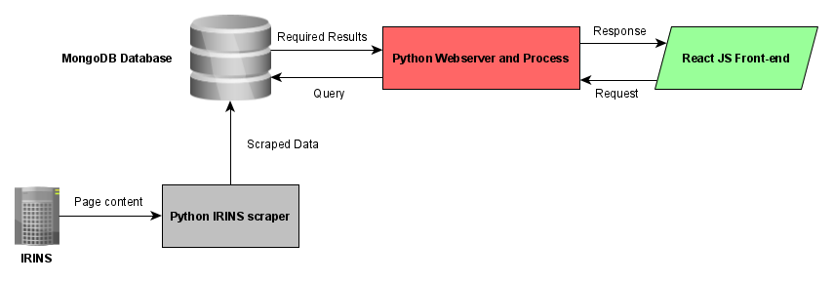
Main Approach:
Take data from IRINS dataset and optimize for better querying. Display the relevant results in an intuitive frontend.
Unique Value Proposition:
Authentic records from credible sources.
No limit regarding quantity of results.
Up-to-date data from source with no scope for bias.
Design Choices:
Monolithic design architecture has been implemented. This is due to time constraints.
Modular setup of application for ease of debugging and scaling.
Known Limitations:
Verified results for fields relating to engineering and sciences.
25 results per page of data.
Simple query comprehension.

Slide 3





Elements:
The technologies used in the tech stack.
MongoDB
Python
Scrapy
Tornado
React JS
Project Inception
Identification of Sources
Science Direct Scraper
ACM Scraper
IRINS Scraper
Flask Server
Tornado Server
React JS
Front End Integration
Intuitive UI Framework
Present Day
Inclusion of other datasets
Optimization of current scrapers
Cloud Migration
Data export

